Slide 1
ZOMATO
Restaurants Analysis
Strategic Expansion & Market Insights

Slide 2








Data Overview
9,551 Total
15+ Countries
21 Attributes
A massive dataset of restaurant listings analyzed to uncover strategic insights and market gaps.
Global coverage revealing vast untapped markets and expansion opportunities outside primary hubs.
Comprehensive data including cuisines, delivery options, pricing, and ratings from 2010 to 2018.

Slide 3
Project Objectives
Zomato operates in 15+ countries with over 9k+ listings globally — yet this dataset reveals massive untapped markets.
Analyze the restaurant dataset across 15+ countries.
Identify low-competition markets for new restaurant openings.
Understand rating drivers: cuisines, delivery, pricing.
Provide data-backed expansion strategy to management.
Build a comprehensive dashboard for interactive decision-making.

Slide 4
Analytical Methodology
01. Data Loading Loaded raw data (9,551 rows × 21 cols). Identified column data types — 9 categorical, 12 continuous.
02. Data Cleaning Used TRIM, CLEAN, Remove Duplicates. Filled missing values via VLOOKUP country codes.
03. Data Enrichment Added Country Name column. Created custom price column with currency symbols using CONCATENATE.
04. Statistical Analysis Used COUNTIF, AVERAGEIF, SUMIF, and Array formulas to answer all 13 objective questions.
05. Dashboard Creation Pivot Tables, Bar/Pie/Column charts. Interactive Dashboard with Country & Year slicers.
06. Strategic Insights Subjective analysis with data-backed suggestions for expansion, cuisines, pricing & delivery.

Slide 5
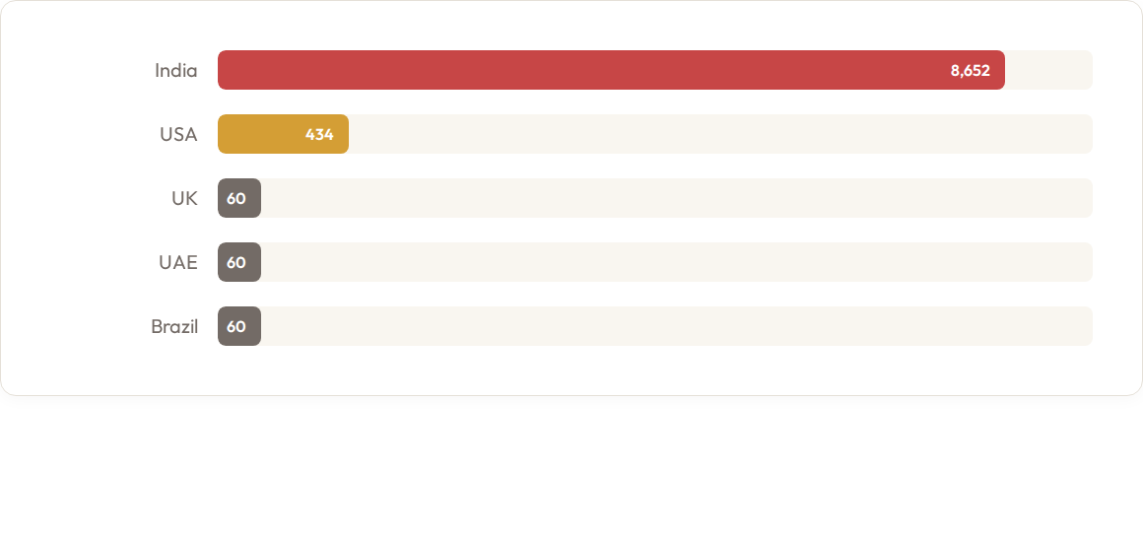
Top 5 Restaurant Distribution by Country
India deeply dominates with 90.6% of the dataset. Countries like the UK, UAE, Brazil & S.Africa each have just 60 listings. This skew reveals vast expansion opportunities outside India.

Slide 6




World-Wide: Key Metrics
★
2.89
₹ 863
Average Cost for Two (INR)
Average Rating
54.4%
Offer Online Delivery
55.3%
Offer Table Booking

Slide 7

Expansion Strategy: Recommended Countries
Target Country | Listings | Avg Rating | Key Market Insight
Indonesia | 21 | 4.30★ | Highest rating. 270M+ pop, 100% premium priced.
Qatar | 20 | 4.06★ | 100% in Doha. Affluent expat market, 70% luxury pricing.
Sri Lanka | 20 | 3.87★ | Colombo emerging food hub. Zero delivery currently offered.
Singapore | 20 | 3.58★ | High-income tech-savvy market. 95% premium priced.
Canada | 4 | 3.58★ | Least penetrated. Massive country with virtually zero presence.

Slide 8
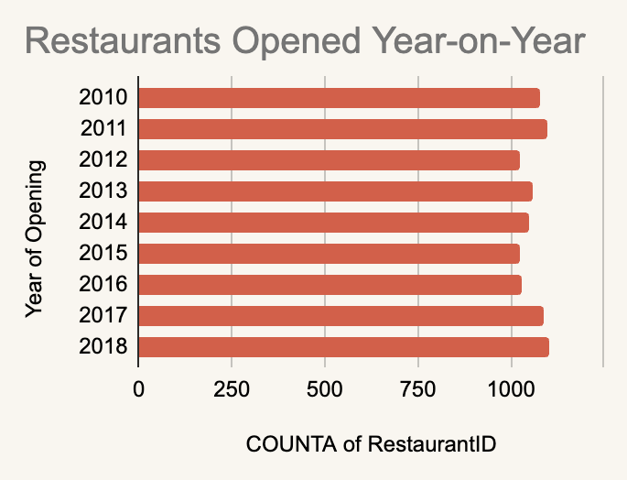
Chart Insights
Remarkable Consistency The data shows an incredibly stable onboarding rate, hovering tightly between 1,020 and 1,100 new restaurant listings every single year from 2010 to 2018.
Mature Expansion Strategy Unlike startups that experience volatile "boom and bust" hyper-growth spikes, this flatline trend indicates a highly controlled, sustainable, and mature approach to market penetration.
Predictable Operational Costs Because the onboarding volume is so predictable year-over-year, Zomato can highly accurately forecast its required sales force, technical infrastructure, and operational expenditure.

Slide 9
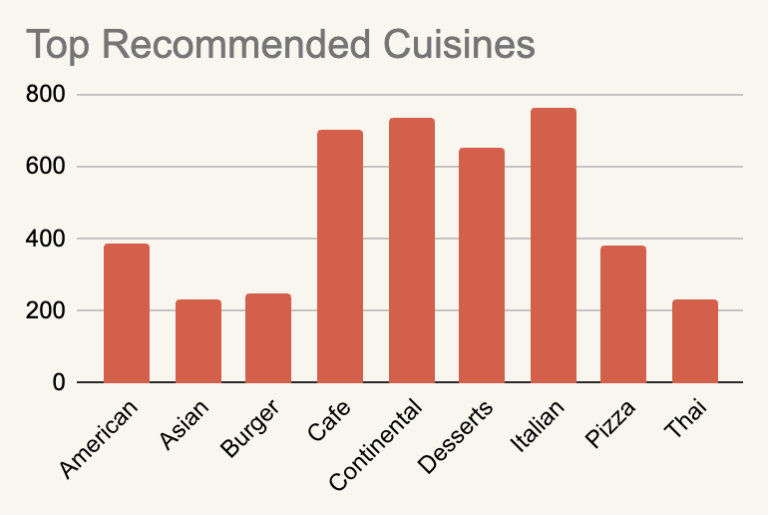
Chart Insights
Selection Criteria To ensure statistical significance, we applied a filter: these cuisines must have a restaurant count of above 200 listings and an average rating > 3.0.
Premium & Cafe Dominance Italian (~760), Continental (~740), and Cafe (~700) are the undisputed leaders. These formats naturally lend themselves to premium pricing and higher experiential dining satisfaction.
The Sweet Spot Desserts (~650) shows exceptionally strong representation. This reveals a massive market for specialty and after-dinner categories that maintain high customer satisfaction scores.
Fast-Casual Foundation Staples like American, Pizza, and Burgers maintain a reliable mid-tier volume (250-400 listings). They are essential for volume but trail the premium categories in sheer recommended count.

Slide 10
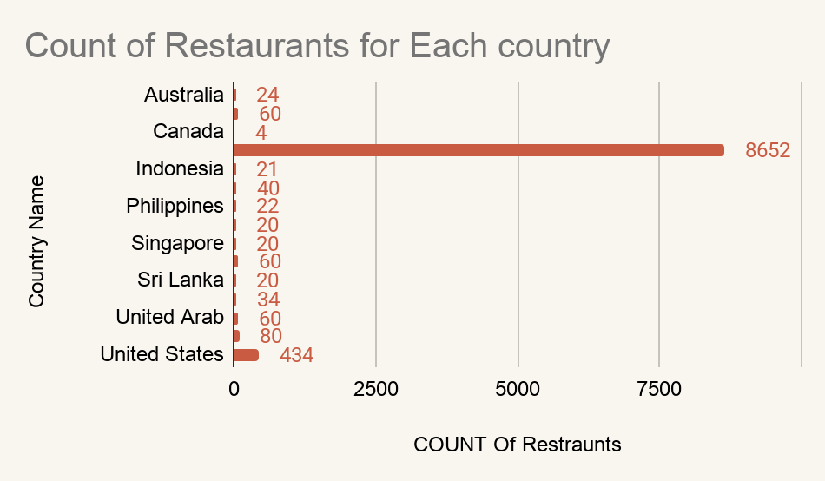
Chart Insights
Geographical Context To analyze the global footprint, we evaluated listings across 15 distinct international markets to assess geographic concentration.
Core Market Dominance India (8,652) is the undisputed leader. The overwhelming concentration indicates the platform's primary operations and major user base naturally lend themselves to the Indian market.
Secondary Hub The United States (434) shows exceptionally strong representation. This reveals a massive secondary market that maintains significant listing volume compared to the rest of the world.
International Long Tail Staples like the UK (80), UAE (60), and Brazil (60) maintain a reliable baseline volume. They are essential for global reach but trail the primary hubs in sheer restaurant count.

Slide 11
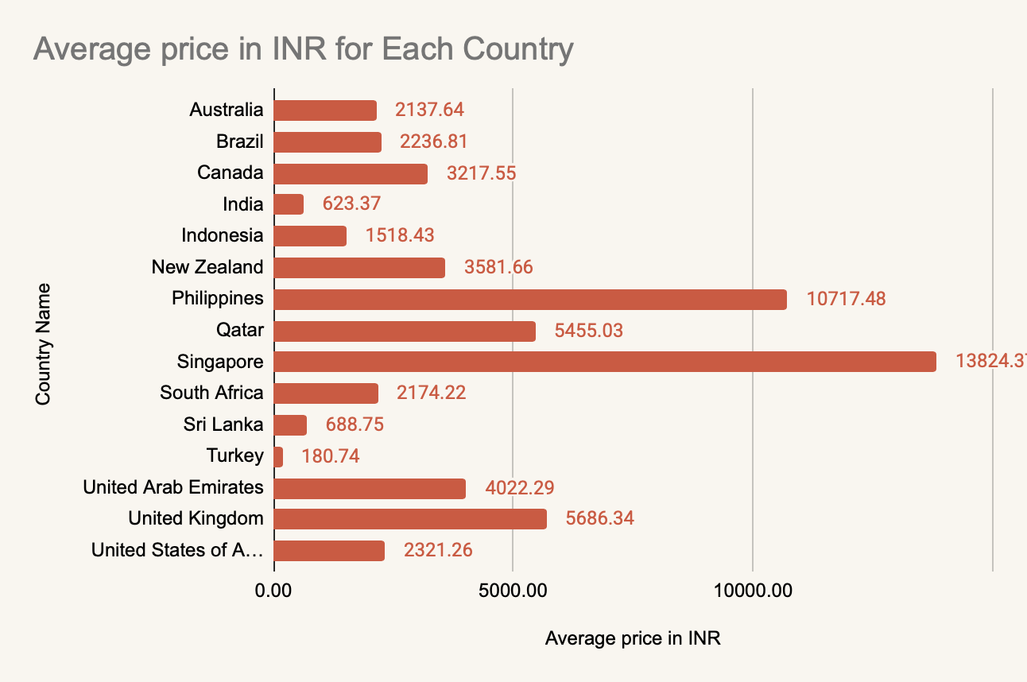

Chart Insights
Pricing Standardization To establish a universal baseline for global dining expenses, average costs for two have been converted directly into Indian Rupees (INR), highlighting massive economic disparities.
Ultra-Premium Outliers Singapore (₹13,824) and the Philippines (₹10,717) are the undisputed leaders. These extreme averages suggest listings in these regions are heavily skewed toward luxury, high-end fine dining rather than casual eateries.
The Mid-Market Squeeze Western and Middle Eastern hubs like the UK (₹5,686) and UAE (₹4,022) maintain a reliable upper-mid-tier average. They completely overshadow established western markets like Canada and the US.
Affordability Foundation Despite dominating the sheer volume of global listings, India (₹623) ranks near the absolute bottom. This confirms the core market strategy relies on highly affordable fast-casual dining to drive mass engagement.

Slide 12
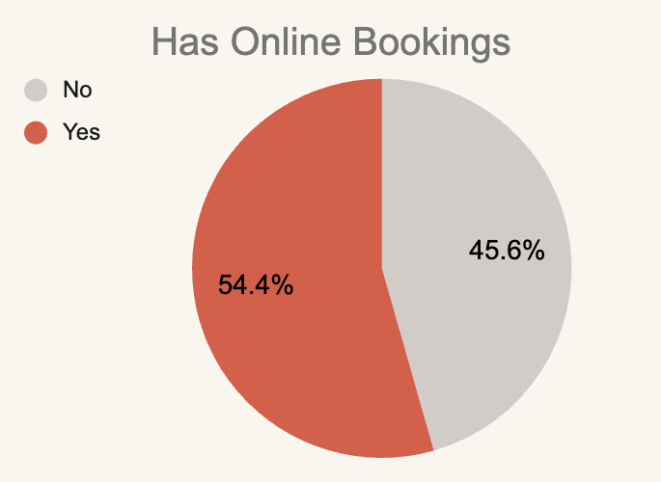
Chart Insights
Understanding the Proportion This 54.4% vs 45.6% split in the chart represents the proportional difference in average ratings between restaurants offering and not offering online bookings.
Massive Rating Boost Our calculations from the Excel sheet show that restaurants with online bookings enjoy a substantial rating advantage, averaging 3.29★ out of 5.0.
The Penalty of Inaction Establishments lacking online booking capabilities average significantly lower, dropping to 2.75★, showing a clear performance drop without digital transaction options.
Clear Service Lift Enabling online booking features drives a net rating increase of +0.54. Seamless transactional convenience is highly valued by consumers and directly impacts peer reviews.

Slide 13
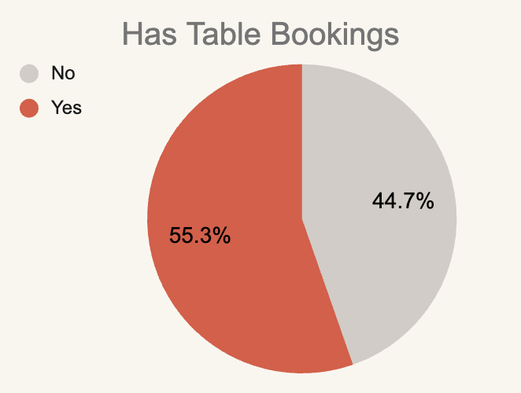
Chart Insights
The Single Highest Impact Feature Offering table bookings is the most powerful operational differentiator in the entire dataset. It drives a massive +0.67 rating boost, lifting a restaurant's baseline from an average of 2.81★ up to a premium 3.48★.
The Premium Expectation The 55.3% share on this chart represents the dominant weight table-booking restaurants hold in overall quality perception. Customers significantly associate the ability to reserve a table with a higher-tier dining experience.
Massive Untapped Market Scarcity Across the global dataset of 9,551 restaurants, a staggering 87.9% do not offer table bookings. This extreme scarcity means introducing this feature provides an immediate competitive advantage to capture premium customers.

Slide 14
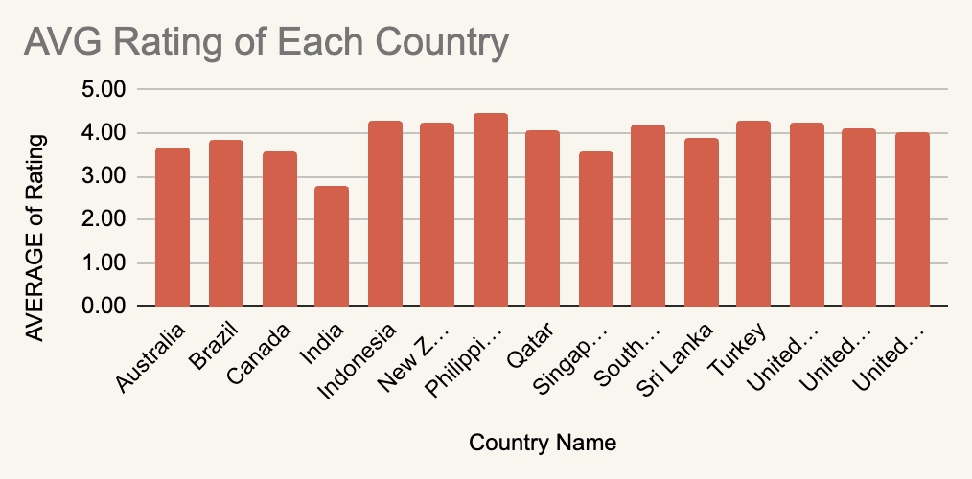
Chart Insights
The Single Highest Impact Feature Offering table bookings is the most powerful operational differentiator in the entire dataset. It drives a massive +0.67 rating boost, lifting a restaurant's baseline from an average of 2.81★ up to a premium 3.48★.
The Premium Expectation The 55.3% share on this chart represents the dominant weight table-booking restaurants hold in overall quality perception. Customers significantly associate the ability to reserve a table with a higher-tier dining experience.
Massive Untapped Market Scarcity Across the global dataset of 9,551 restaurants, a staggering 87.9% do not offer table bookings. This extreme scarcity means introducing this feature provides an immediate competitive advantage to capture premium customers.

Slide 15
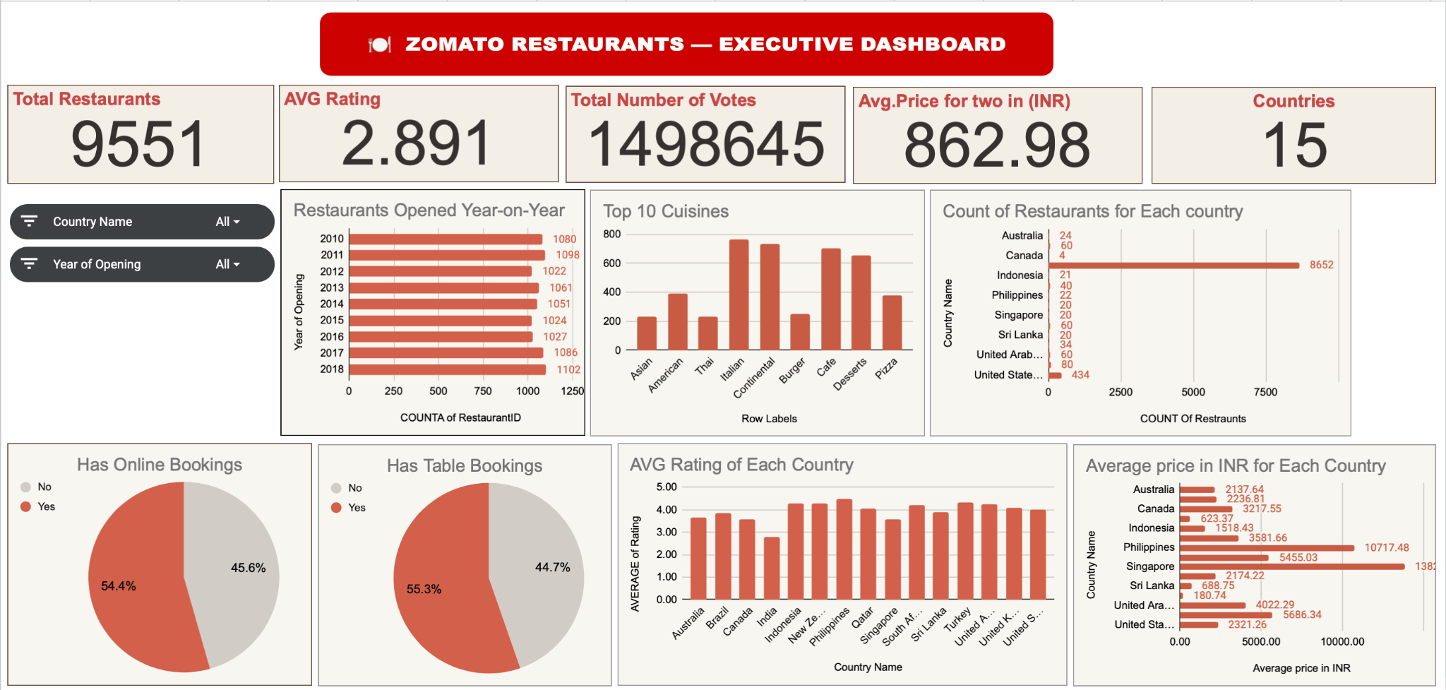

Slide 16


Strategic Recommendations
01. Enter Indonesia & Qatar First
04. Target Pilot Cities
Indonesia leads with 4.30 IN Rating. Qatar has 70% luxury pricing in Doha with a high-spend expat base ready to adopt the platform.
100% of Qatar & Sri Lanka listings are in Doha & Colombo. Concentrate launch resources in these single-city markets for maximum impact.
02. Launch Online Delivery
05. Premium Positioning
0% of restaurants in all 5 target countries currently offer Zomato delivery. Massive first-mover opportunity that can double ratings.
Qatar & Singapore are already 70–95% premium. Match or slightly undercut local premiums to attract quality-conscious customers.
03. Localize Cuisine Strategy
06. Canada Greenfield Play
Western & Indonesian dominate in Jakarta. Indian leads in Qatar. Sri Lanka & Singapore prefer American & local styles.
Massive country with virtually zero Zomato presence. Ideal for phased, long-term expansion utilizing mid-range pricing.

Slide 17







Executive Conclusion
Market Opportunity
Product Strategy
Financial Insight
Indonesia, Qatar & Sri Lanka offer the best entry points. They combine high ratings (3.87–4.30★) with low competition and a 0% delivery coverage, creating a massive first-mover advantage.
Match local cuisines strictly. Enable delivery from Day 1 as a core differentiator, as none of the top 5 expansion countries currently offer it through the platform.
Align pricing with established local norms. Qatar and Singapore are already heavily premium-priced, allowing Zomato to capture immediate, high-value market share.

Slide 18
THANK YOU

